Slide 1
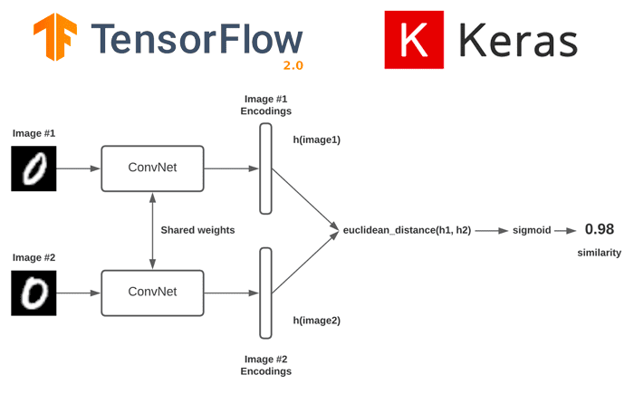
ROBOTS COLORING BOOK - PICTURE 2
DEEP LEARNING:-
Siamese Networks:
Siamese networks are often used as the architecture for self-supervised learning in remote sensing. They consist of two identical subnetworks (twins) that share weights. These networks are trained to embed similar samples close to each other in the feature space while pushing dissimilar samples apart.
Siamese Network on Find Similarity between 2 Image Feed

Slide 2
ROBOTS COLORING BOOK - PICTURE 2
10
1. Architecture:
A Siamese network consists of two identical subnetworks, often referred to as "twins" or "arms," which share the same architecture and weights. These twin networks take individual input samples and produce corresponding feature embeddings. The two arms are trained simultaneously and independently.
2. Objective:
The main goal of a Siamese network is to learn a similarity metric in a way that makes the embeddings of similar or positive pairs (pairs of data points that are similar or should be close in the feature space) close to each other while pushing apart the embeddings of dissimilar or negative pairs (pairs of data points that are different or should be distant from each other).
3. Training Process:
The training process of a Siamese network involves the following steps:
Pair Generation: Pairs of data points are generated for training. In the context of remote sensing or image processing, this could involve taking two images or image patches, one as a positive example (similar) and the other as a negative example (dissimilar).
Forward Pass: Each input sample from a pair is fed into its respective arm of the Siamese network, producing feature embeddings.
Embedding Comparison: The embeddings produced by both arms are compared using a distance metric, such as Euclidean distance or cosine similarity, to measure their similarity.
Loss Calculation: A contrastive loss function is used to calculate how well the Siamese network is performing. The loss encourages the network to minimize the distance between embeddings of similar pairs and maximize the distance between embeddings of dissimilar pairs.
Backpropagation: Gradients are computed through the Siamese network, and the weights are updated using an optimization algorithm like stochastic gradient descent (SGD) or Adam to minimize the loss.

Slide 3
ROBOTS COLORING BOOK - PICTURE 2
10
4. Use Cases:
Face Verification: Siamese networks are commonly used in facial recognition systems to verify whether two face images belong to the same person.
Signature Verification: In signature verification tasks, Siamese networks can determine the authenticity of a signature by comparing it with a reference signature.
Object Recognition: They are used in object recognition tasks where the network learns to recognize objects by comparing their features to a database of known objects.
Anomaly Detection: Siamese networks can also be used for anomaly detection, where they learn to identify deviations from normal patterns by comparing new data points with those from a training dataset.

